Slide 1
Leveraging Rancher Federal within the U.S. Government/Public Sector
Zack Brady – Field Engineer zack.brady@rancherfederal.com

Slide 2

Introductions / Overview
What’s a Container? Kubernetes?
Why Rancher Federal
Open-Source Ecosystem
The Rancher Federal Approach
Demo / Workshop (my favoirte)
Q & A Session
Today’s Agenda
Notes:
2

Slide 3

About Me…
DoD/IC Contractor
U.S. Military Veteran
Built/Exited a Digital Firm
Open-Source Contributor
Career of Software/DevOps
Active Volunteer FF/EMT
Zack Brady – Field Engineer zack.brady@rancherfederal.com

Slide 4
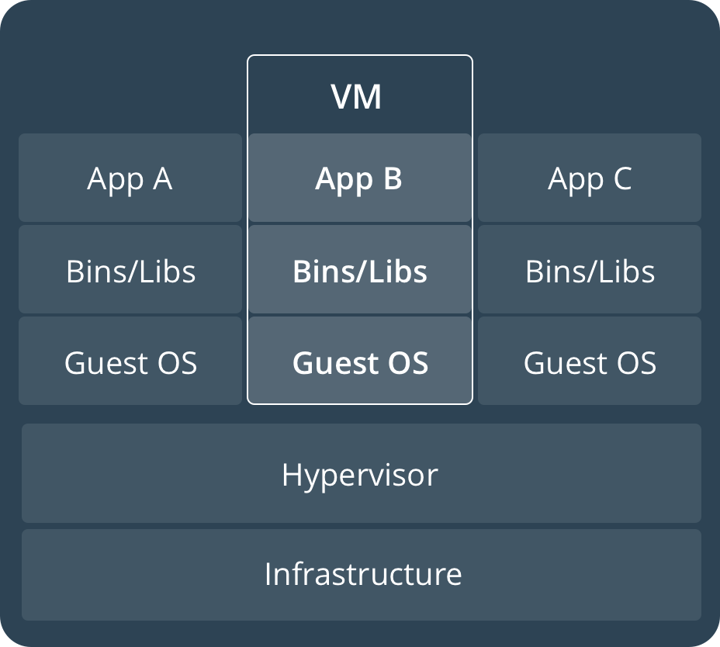
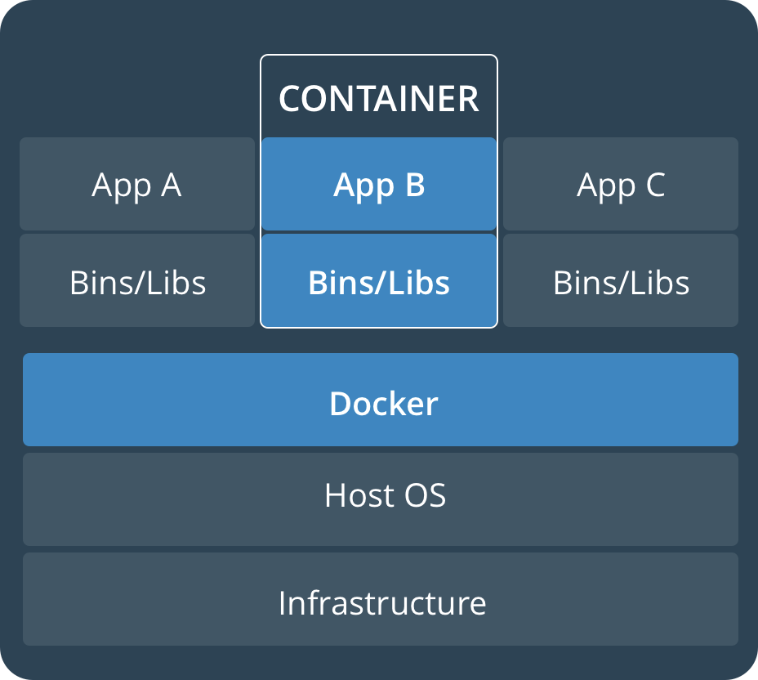
Virtual Machines vs Containers
Notes:
4

Slide 5
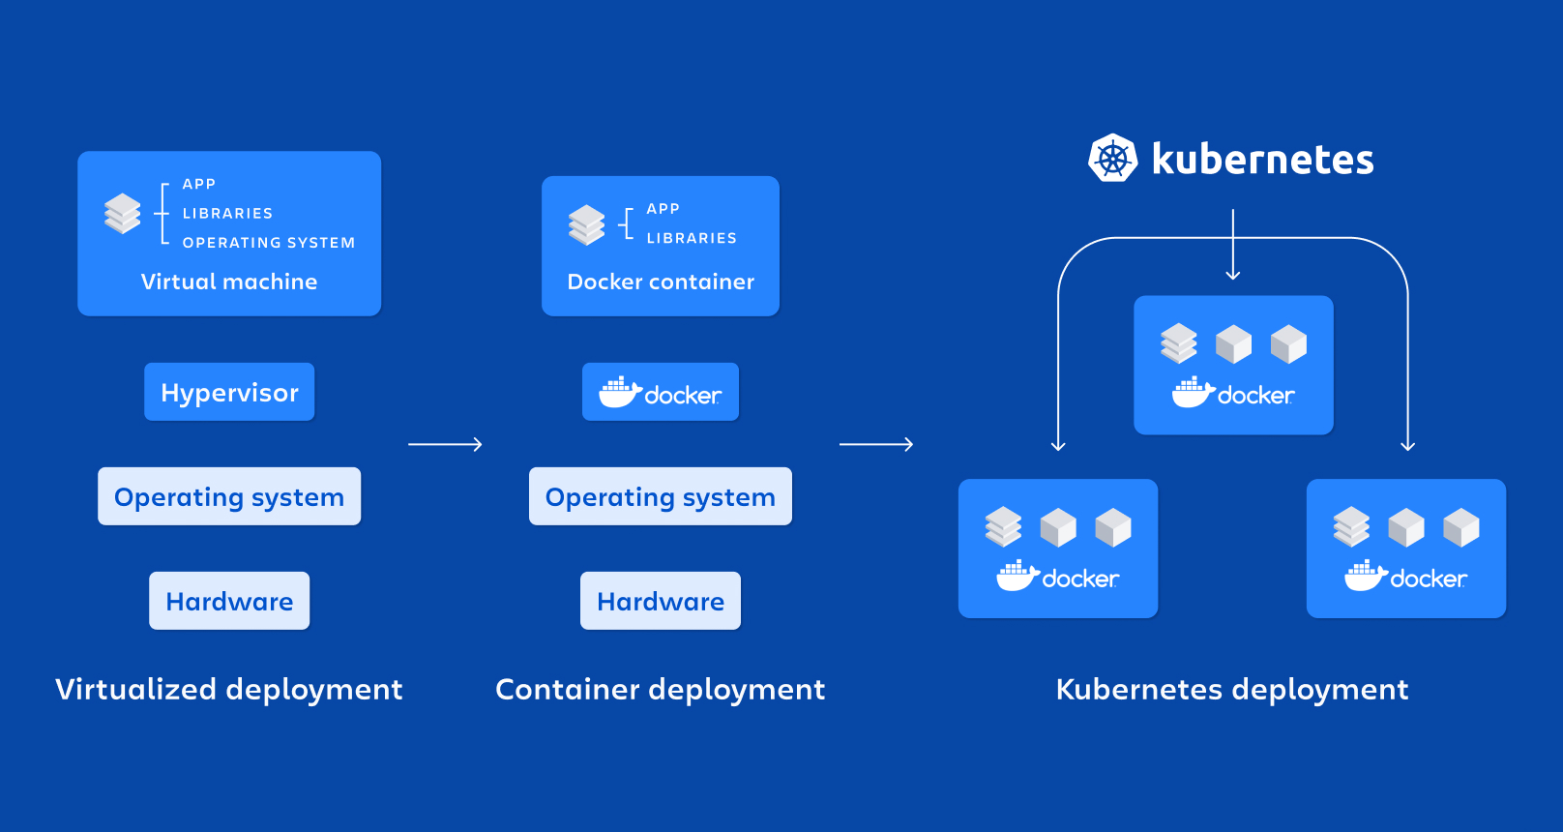
VMs -> Containers -> Kubernetes!
Notes:
5

Slide 6

Rancher Government Solutions
Engineering Cloud Native Computing Platforms for the US Government
Rancher Federal (RGS) is a 100% US-based entity dedicated to delivering Kubernetes and Cloud Native Technology solutions and support across the DoD, IC, and Federal community.
Rancher Federal (RGS) offers varying levels of service including US-State Side Support and cleared on-site support.
Rancher Federal (RGS) exists to enhance Rancher’s capabilities to meet the ever-evolving Federal mission requirements.
STIG/CIS Hardening & Validation
SELinux & FIPS Compliance
Air-Gapped , C2S, SC2S, GovCloud Support
Enterprise Audit Functionality
PKI Authentication
Notes:
6

Slide 7



Rancher’s Three Pillars of Success
Accelerating Mission and Driving Success
Enterprise Support
Professional Services
Mission - Accelerator
24/7/365 U.S./CONUS based Enterprise Support for Rancher and the Kubernetes Ecosystem.
Technical Account Manager and Bootstrap Architecture Support
Cleared Onsite Engineers and Support Teams
70% of RGS hold a TS//SCI or higher clearance
Continuous Training & Education
On-Site, On-Premises, or Remote Cleared Engineers
Cloud-native Advocates and Evangelists focused on bootstrapping or delivering customer success
Multiple Prime Contracts at USAF PlatformOne and many Subcontracts across the DoD/IC Communities
Ranges from Hands On Support to Quarterly Meetings
Dedicated to weaponizing the Rancher products to work better in airgap/offline/classified mission environments
Bringing a security-first mindset to the Rancher capabilities by baking in NIST FIPS-140-2/3 encryption & DISA STIG certification/validation
Collaborated to develop the RKE Government/RKE2 secure-by-default Kubernetes distribution
Notes:
7

Slide 8

















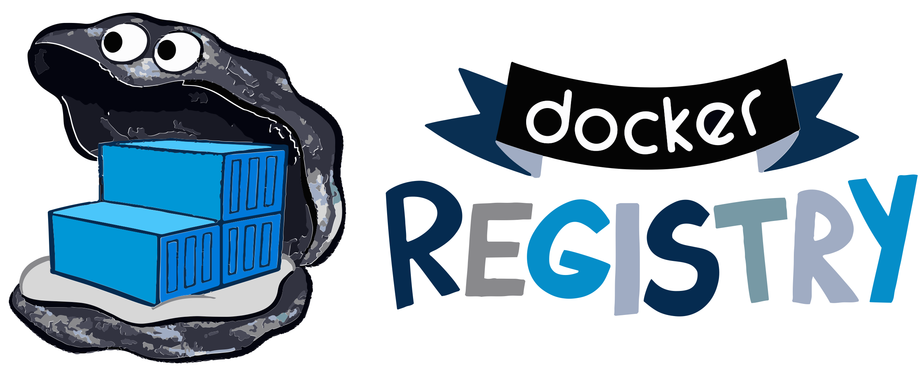












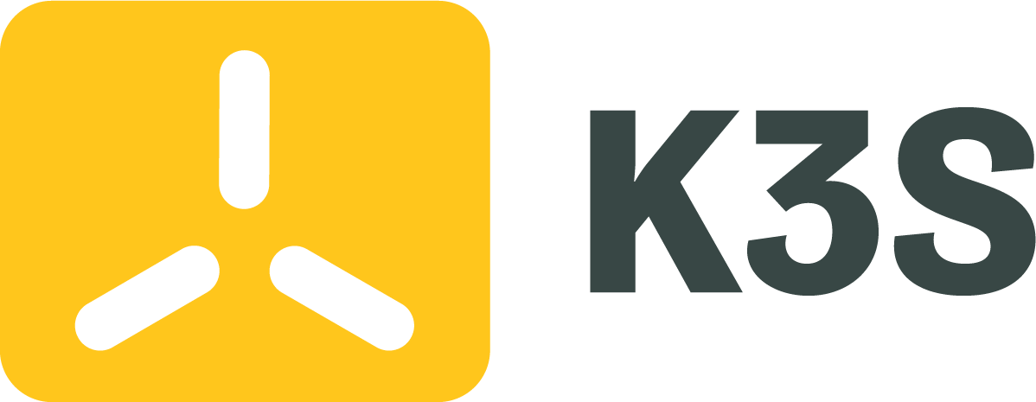

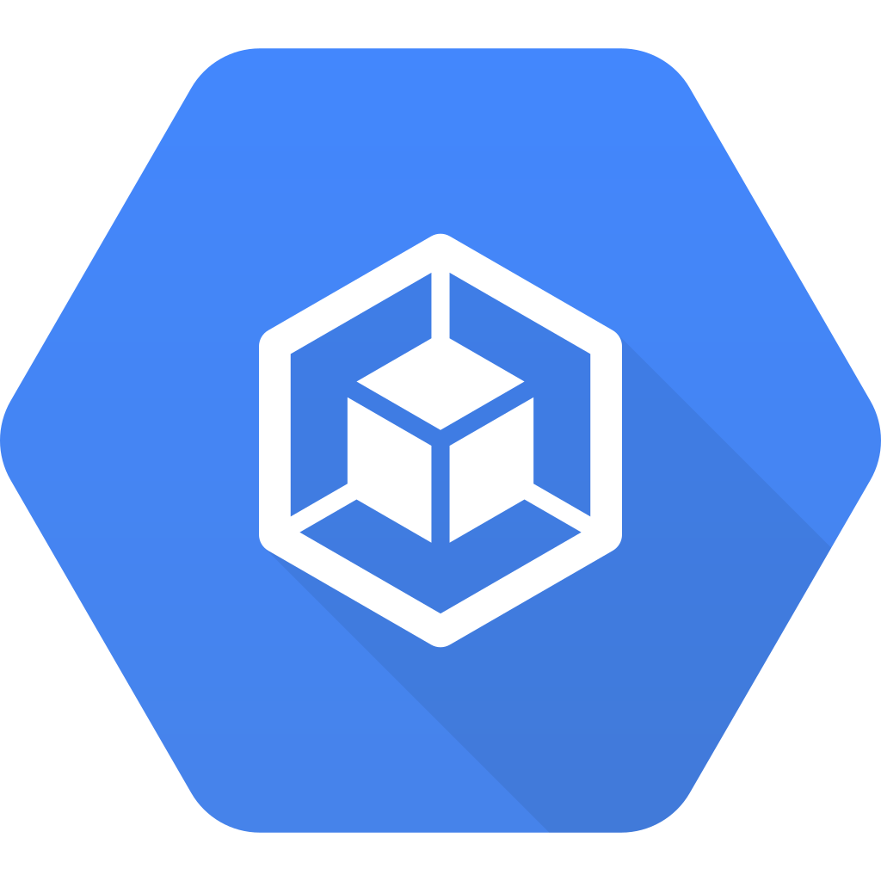
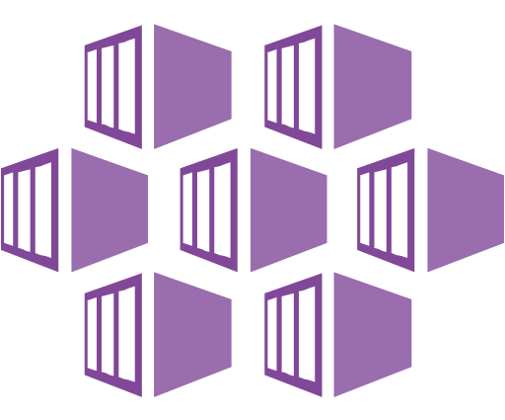



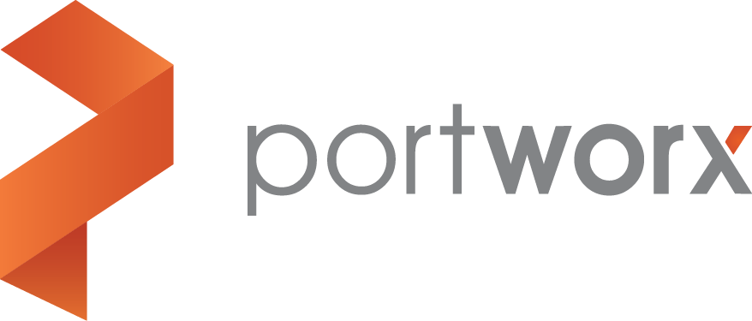

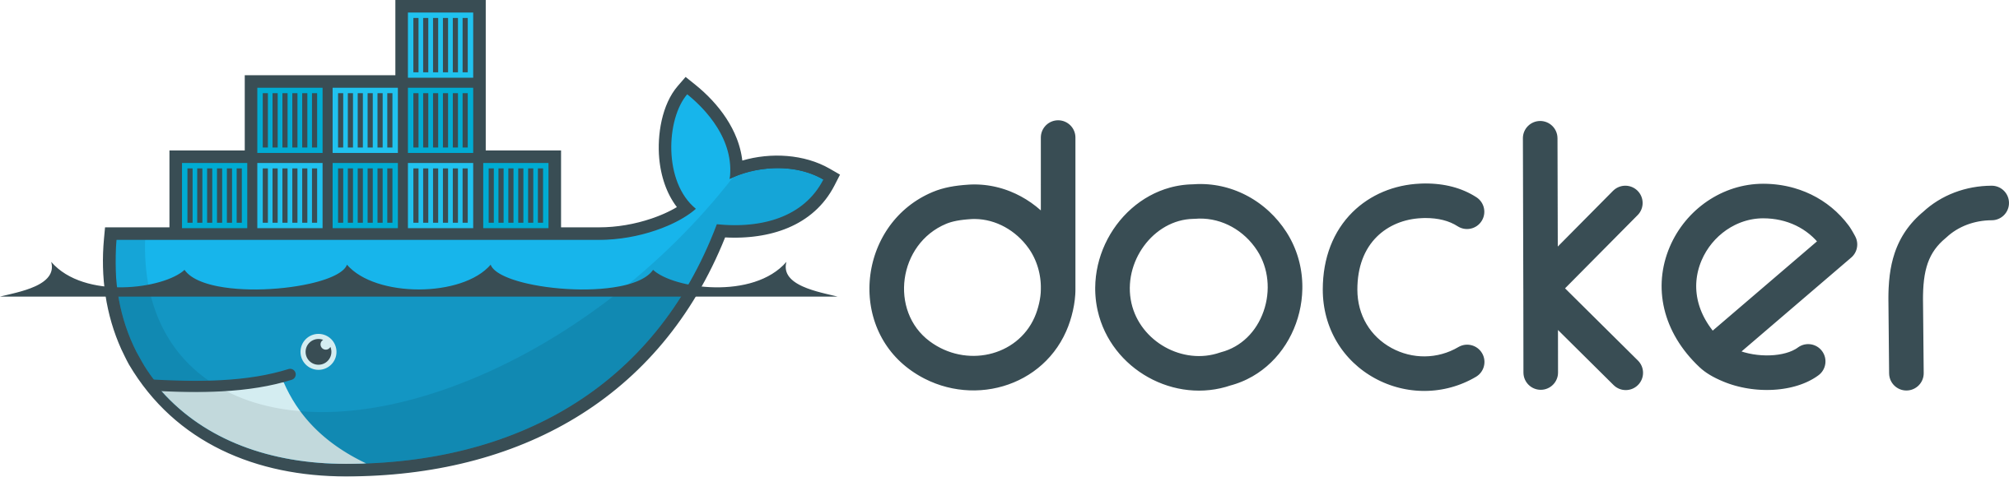









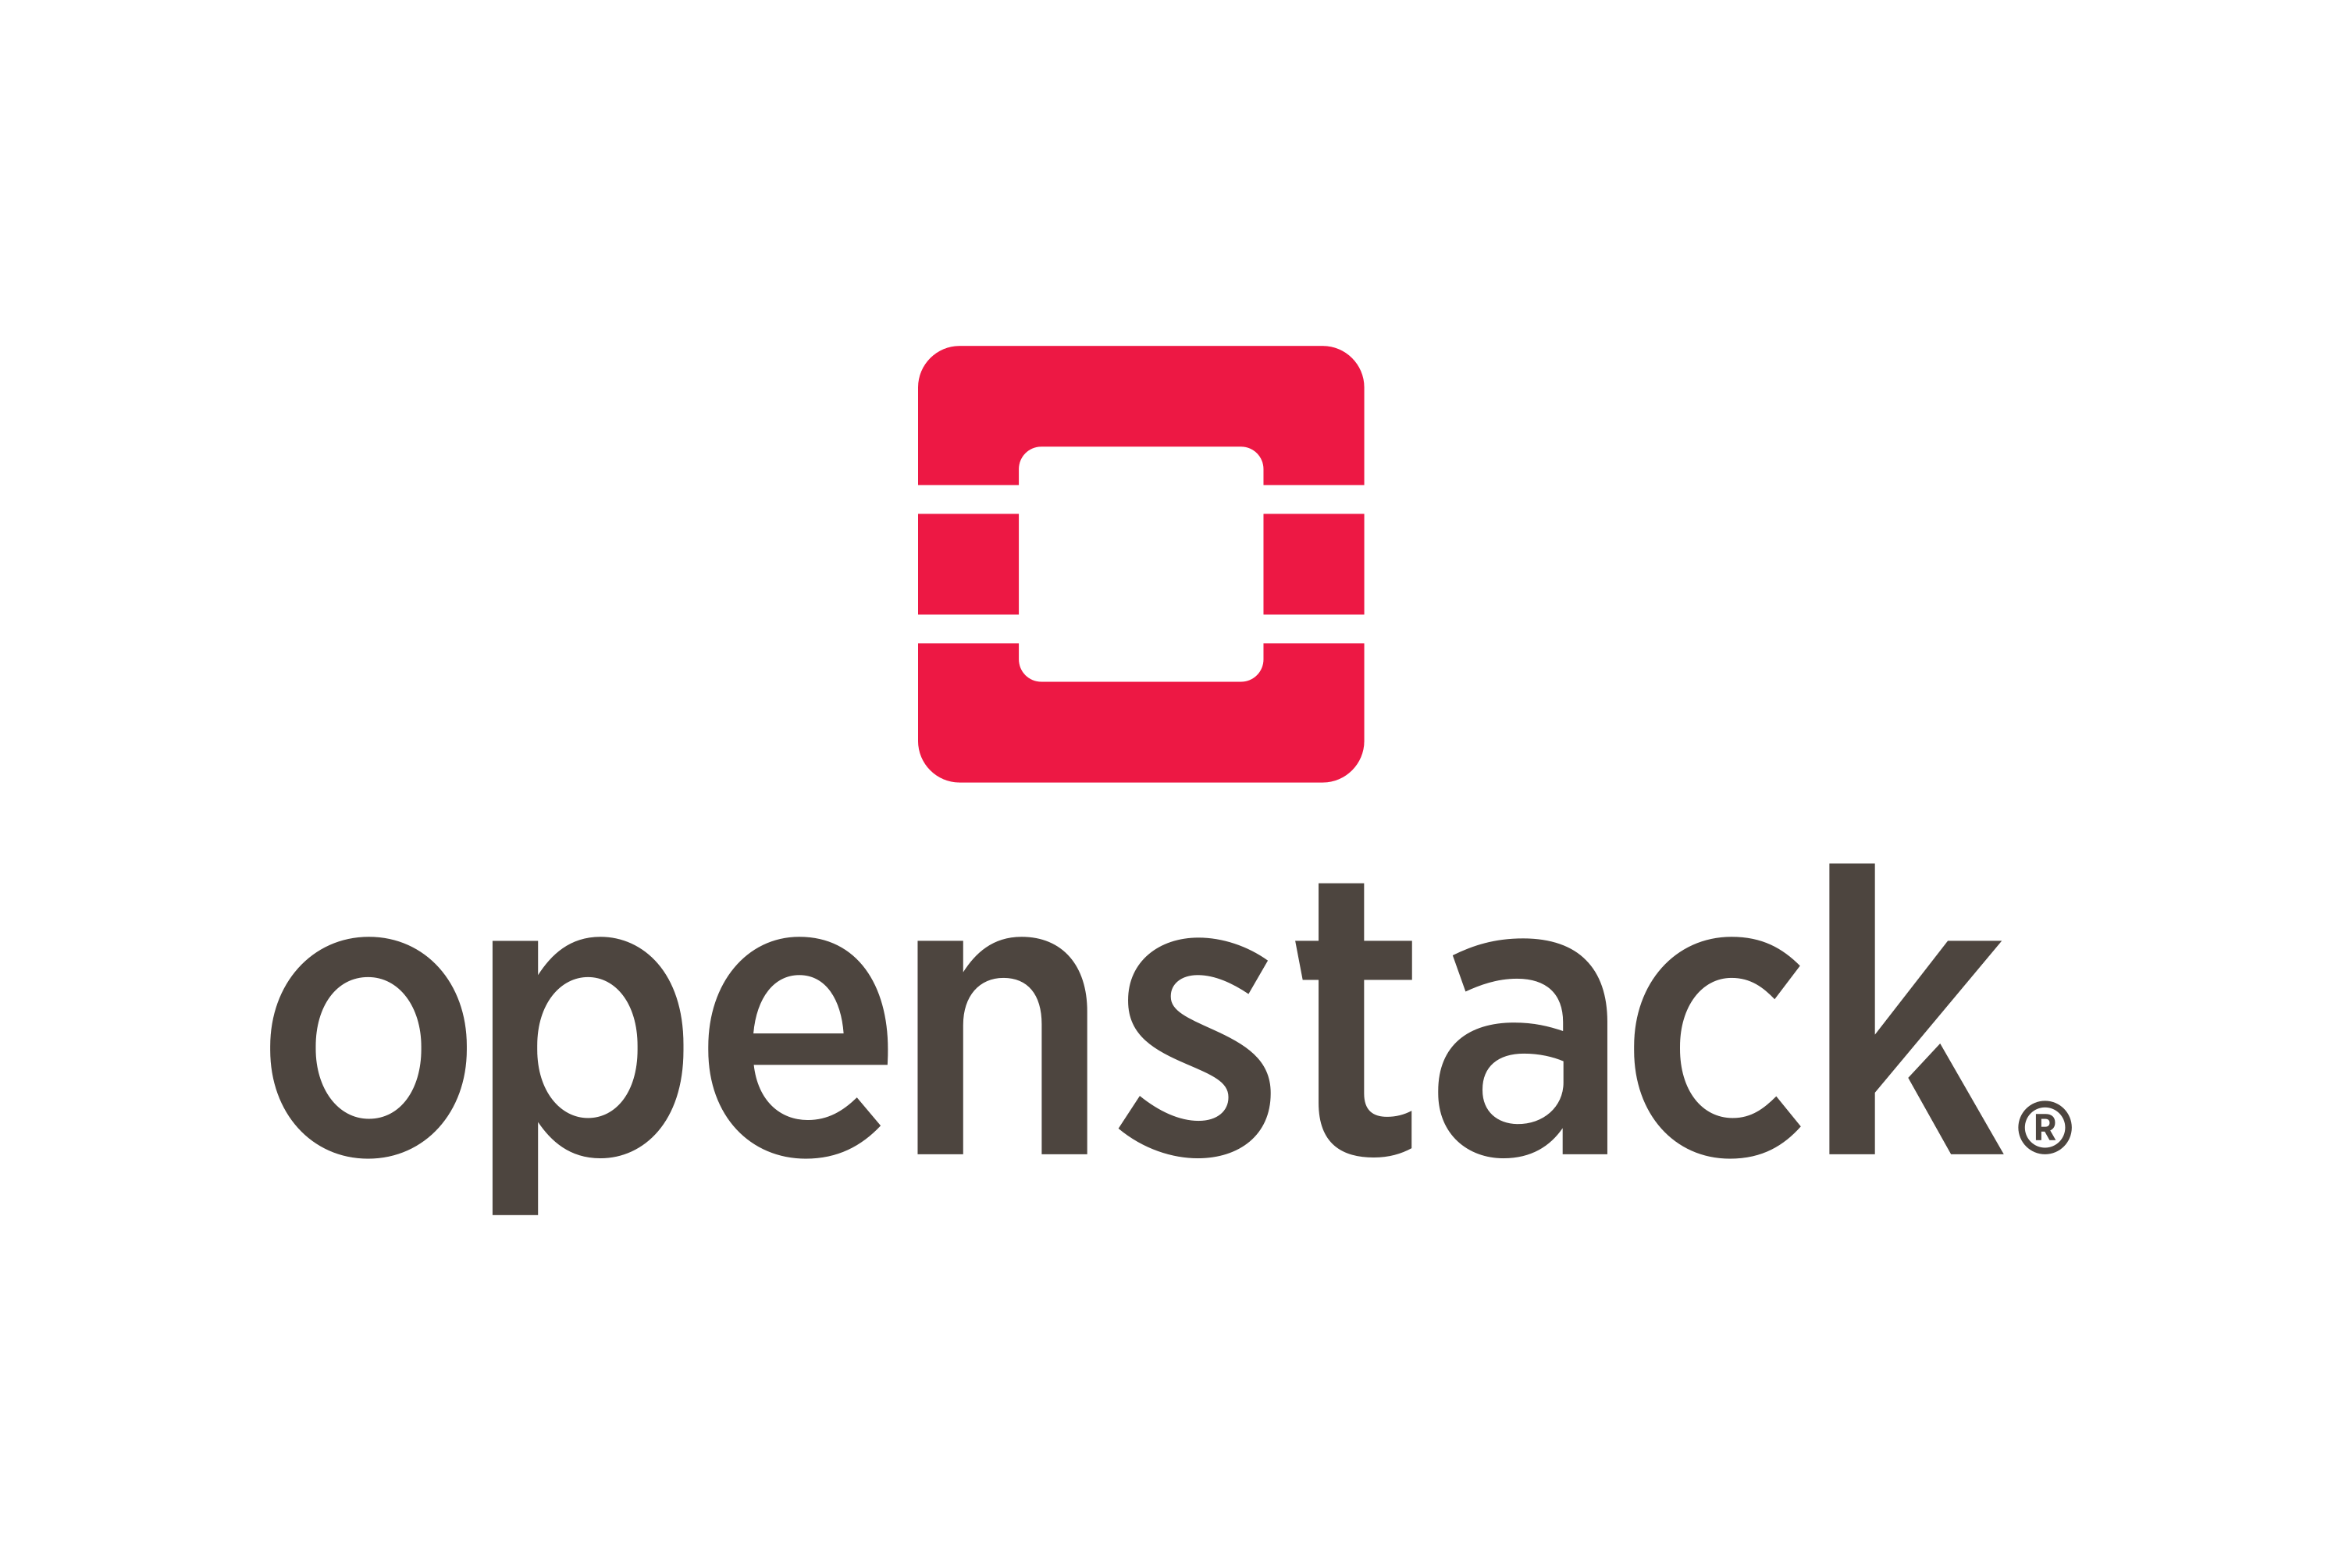
The Complete Rancher Stack
Rancher SLA
Certified Integrations
Authentication & Authorization
App Management & CI/CD
Monitoring & Logging
Registry & Image Scanning
Container Security & Secrets
Networking & Service Mesh
Platforms & Orchestration
GKE
AKS
Persistent Storage
Container Engine
Operating Systems
Infrastructure Drivers
8
Notes:
8

Slide 9









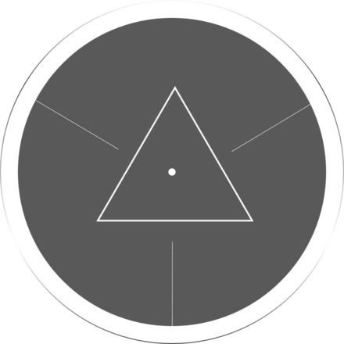






Worried about STIGs? Concerns with ATOs?
9

Slide 10
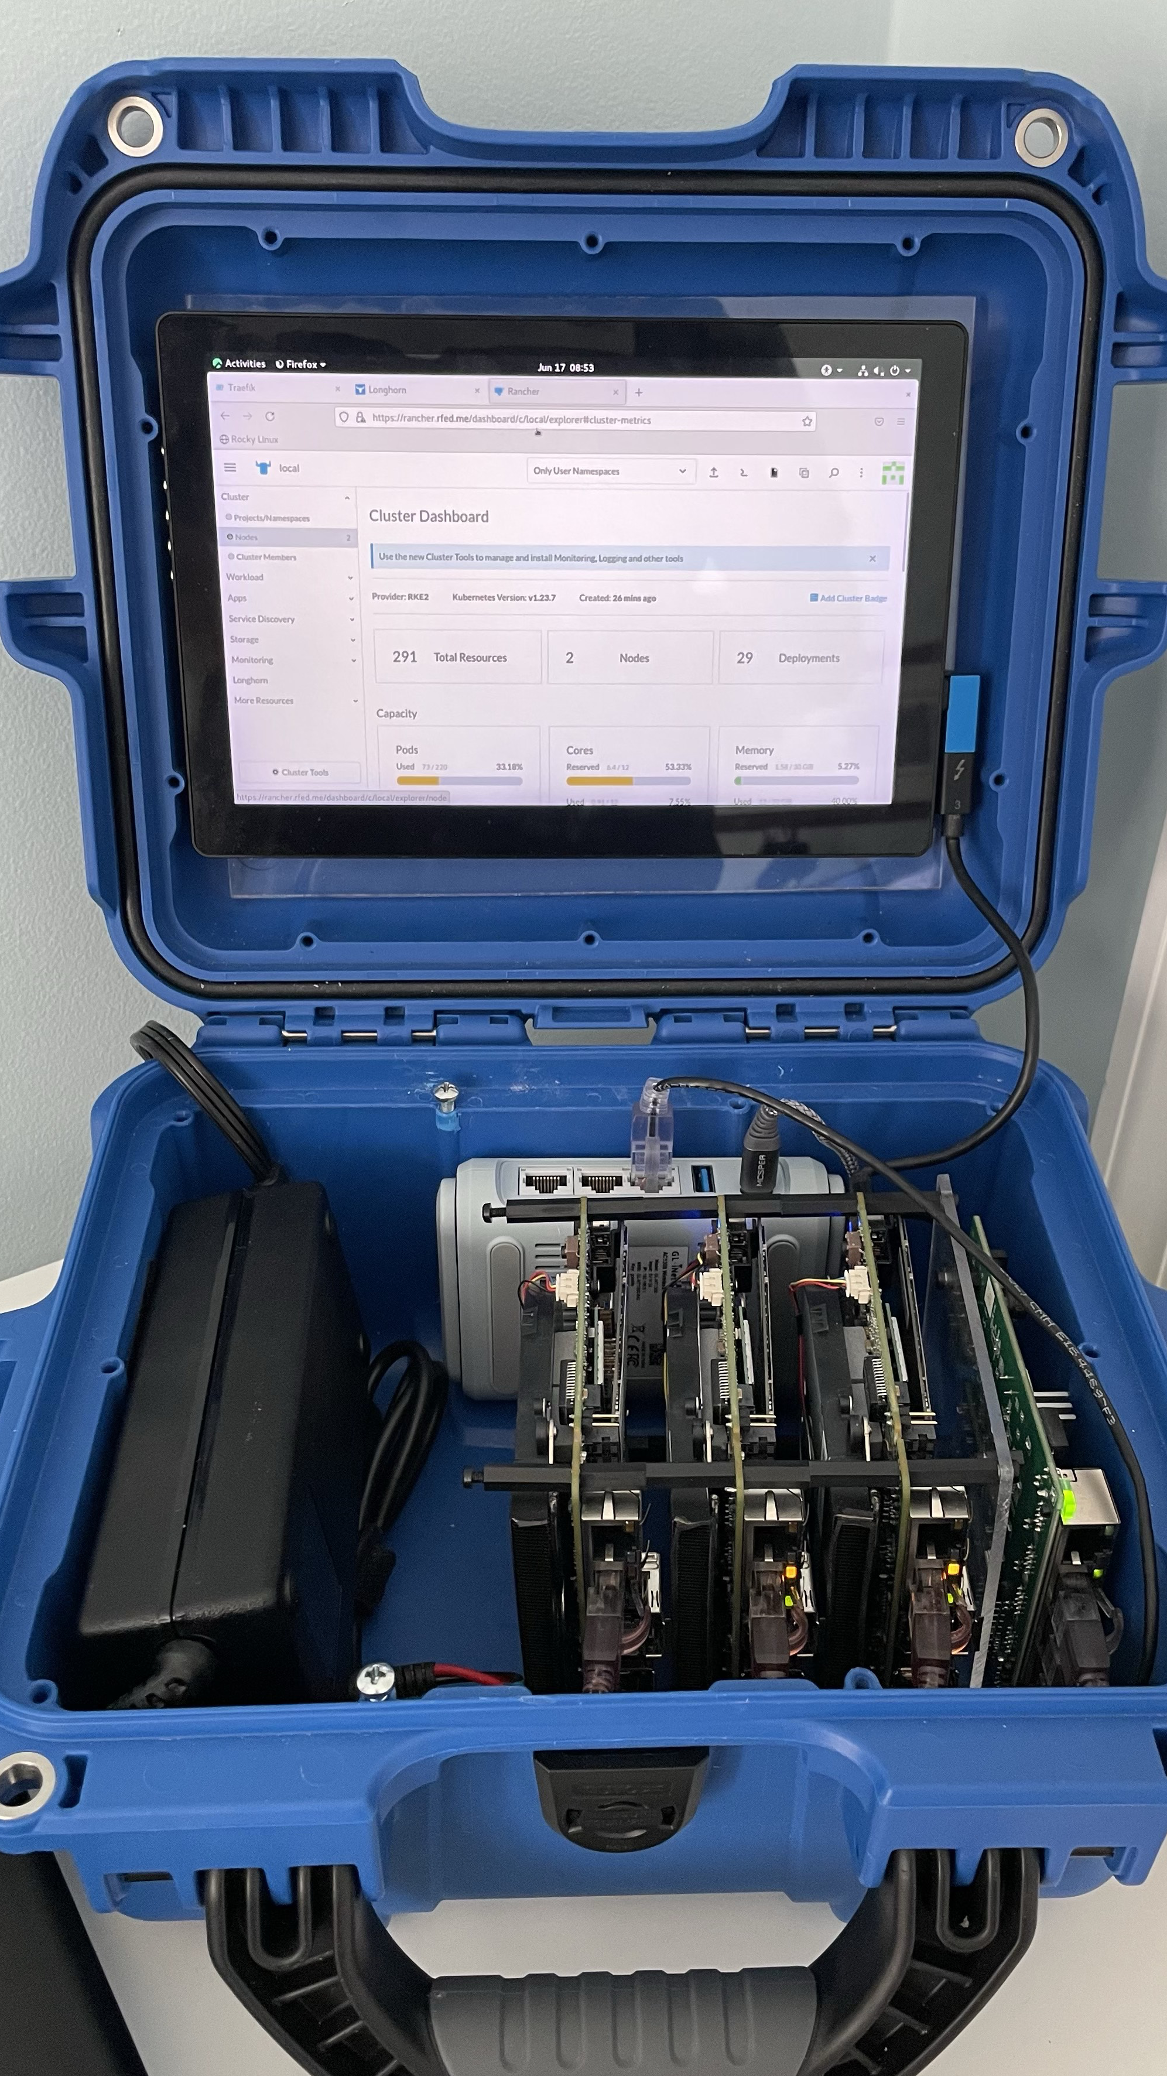
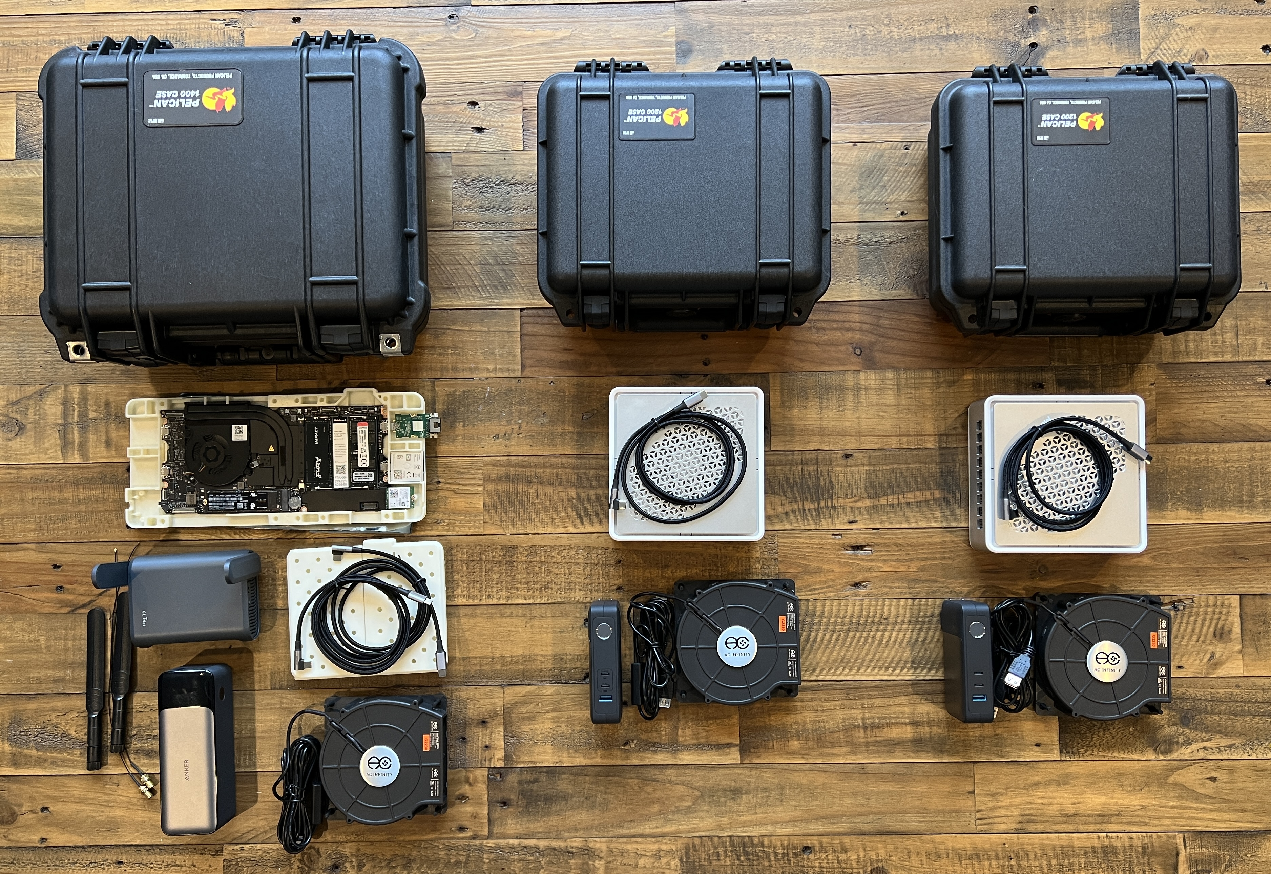
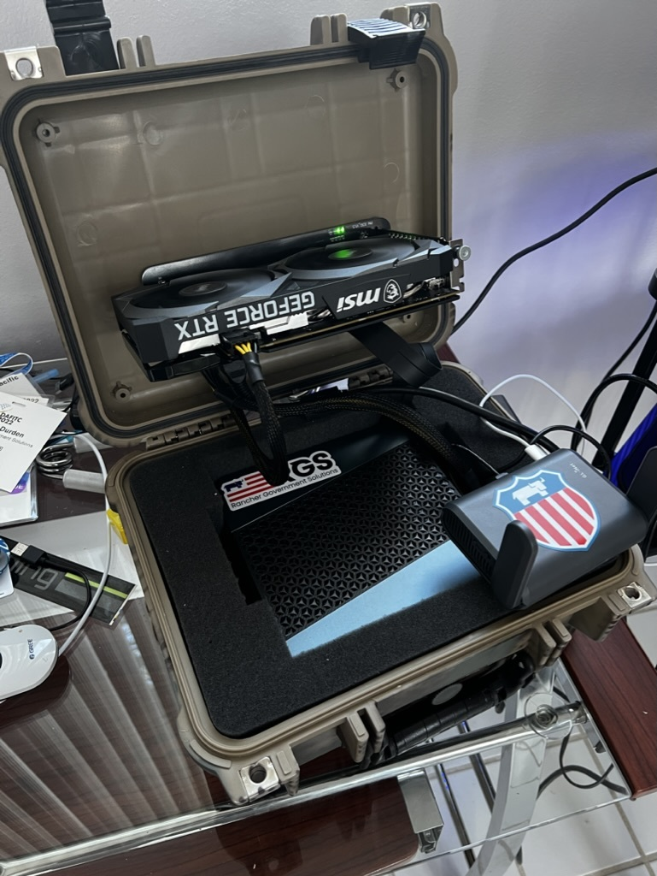
From Datacenters to the Edge…
10

Slide 11
Break!!
and then our…
Demo/Workshop!
https://workshop.rancherfederal.io/

Slide 12
Rancher Federal + Amazon AWS
Rancher is the leading Kubernetes distribution and Kubernetes platform.
Amazon AWS is the leading and most adopted cloud provider.
But what does that mean for our customers?
Rancher Federal and Amazon AWS have partnered together to develop a marketplace offering to dramatically reduce the barrier to entry to Kubernetes.
This offering is a highly available free trial of RKE2 and Rancher Manager on AWS GovCloud (US), designed strictly for use only by U.S. Federal Government and U.S. Public Sector Customers.
http://tryranchergov.com/
https://github.com/zackbradys/rancher-on-aws
12

Slide 13
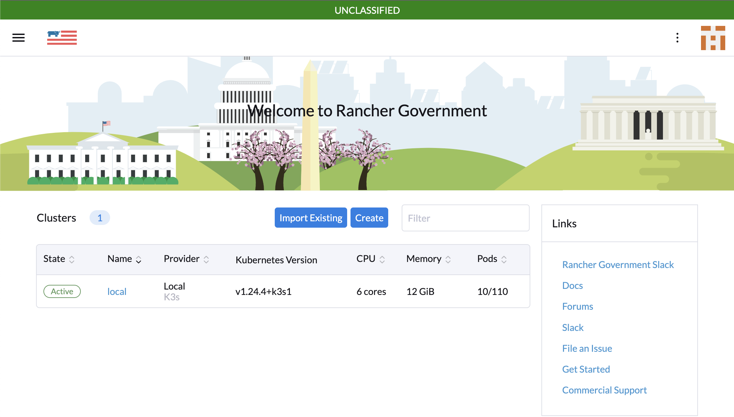
What’s Next for Rancher Federal…
Rancher Carbide
Secure and Trusted Container Registry (Azure Gov)
Government STIG Validation (STIGATRON)
Supply Chain Management (SUPPLYATRON)
Offline Rancher Docs
SLSA3/SBOMs/Scans
Built for our U.S. Government Support Customers (Licensed)

Slide 14
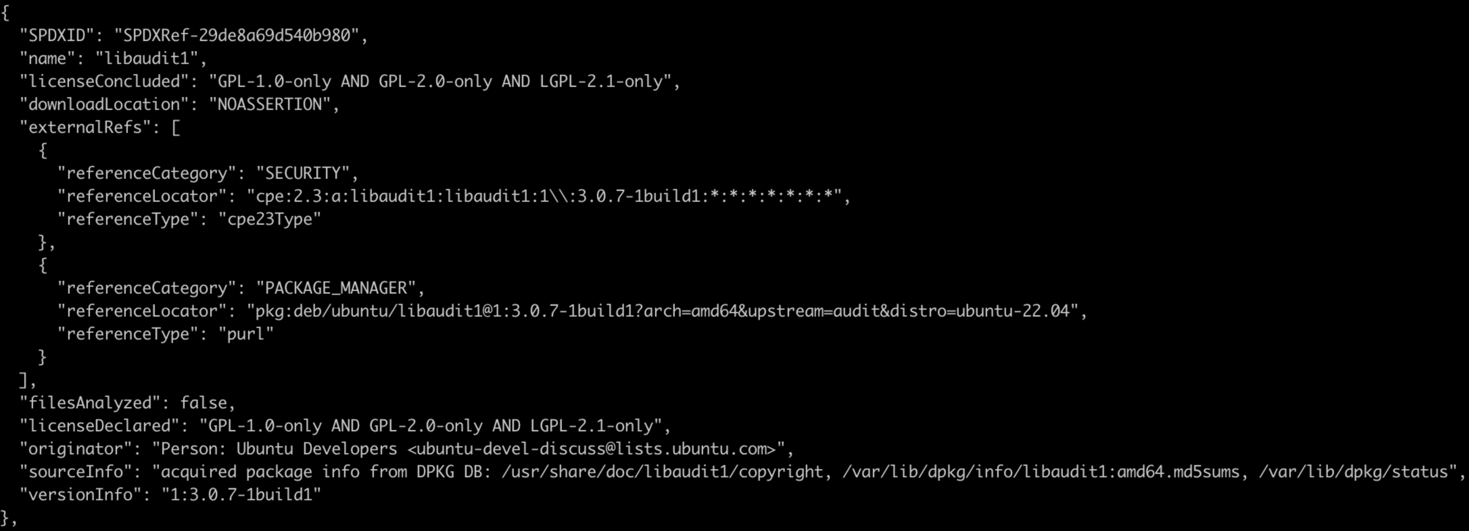
Software Bill of Materials
14

Slide 15
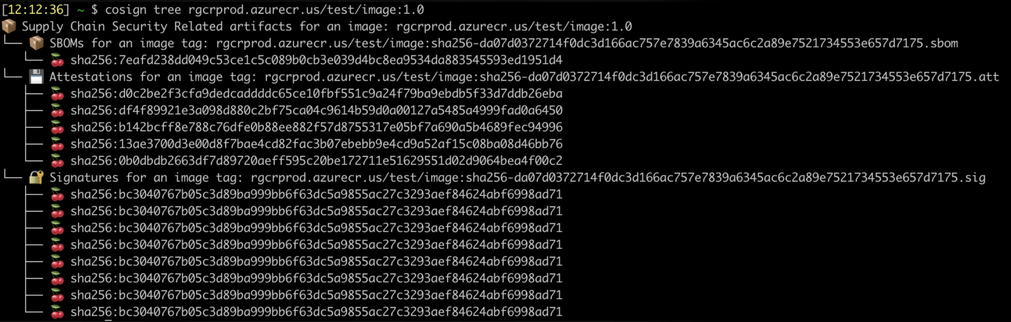
Image Attestation Reports
15

Slide 16
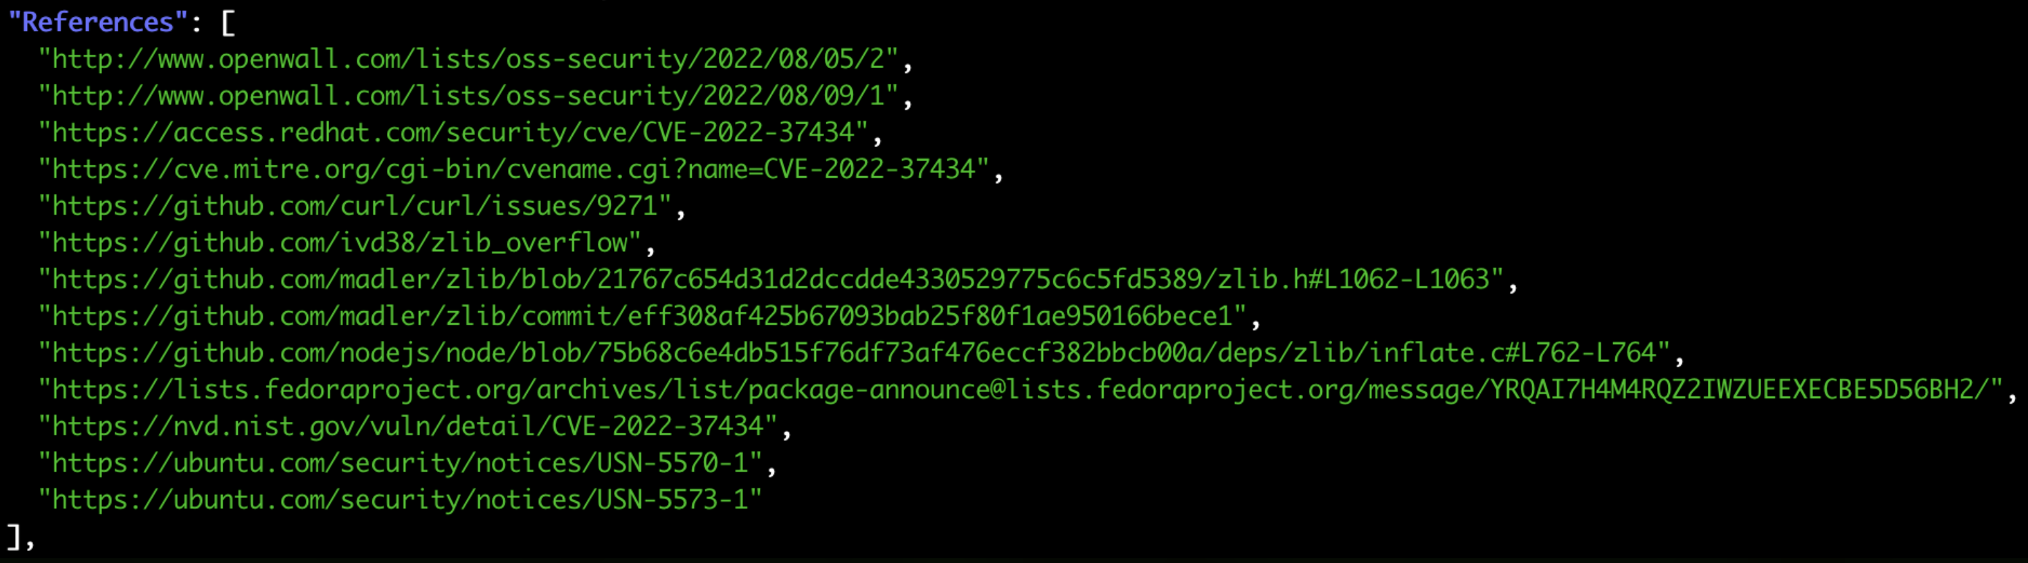
Image Vulnerability Scans
16

Slide 17
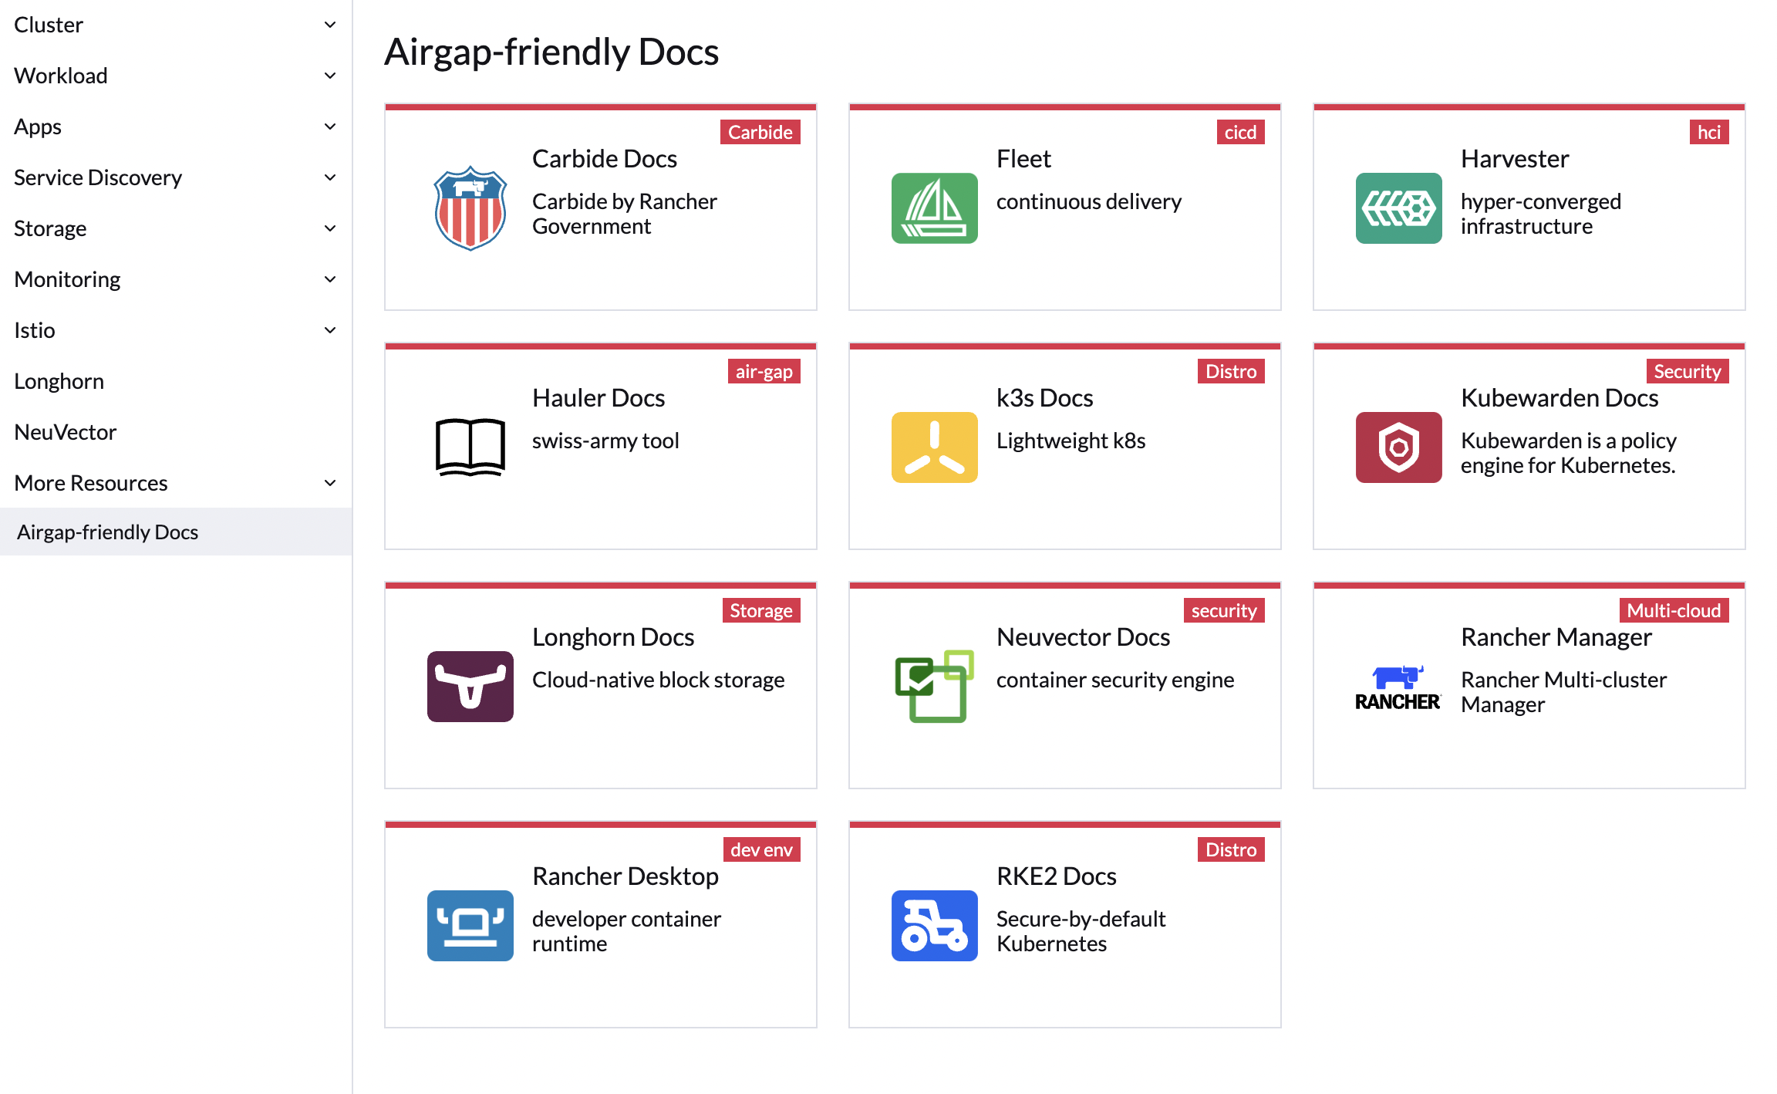
Rancher Offline Docs
17

Slide 18
Thank you for your time today!
Email: zack.brady@rancherfederal.com
GitHub: https://github.com/zackbradys
Website: https://rancher.com/government
Cage Code: 8GLZ3
DUNS: 117387835

Slide 19

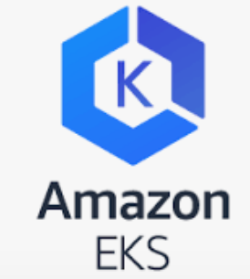
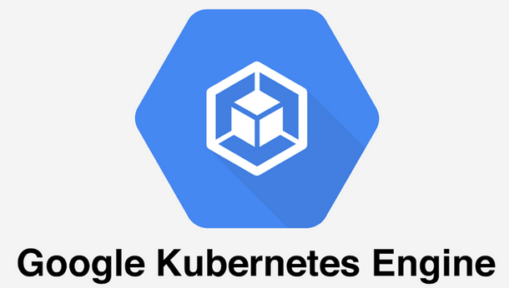
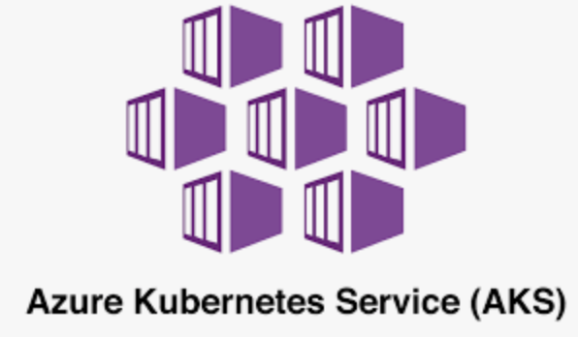
Recommended Architecture
Rancher Management Server Cluster
Rancher Management Server Cluster
Highly Available
Node
Node
Node
Production Environment
Additional Environments
Highly Available
Node
Node
Node
(cp/etcd/worker)
(cp/etcd/worker)
Cluster 1 (Prod)
Cluster 2 (Prod)
Cluster 1 (Dev/Test)
Cluster 2 (Dev/Test)
Control Plane
Node
Node
Control Plane
Node
Node
Control Plane
Node
Node
Control Plane
Node
Node
etcd
Node
Node
Node
etcd
Node
Node
Node
etcd
Node
Node
Node
etcd
Node
Node
Node
Worker
Node
Node
Node
Worker
Node
Node
Node
Worker
Node
Node
Node
Node
Worker
Node
Node
Node
Node
Cluster 3 - Hosted (Prod)
Control Plane
Node
Node
Cloud Hosted Environment on GKE, EKS, AKS, etc
The Rancher Management Server cluster manages all downstream k8s. The k8s required to run Rancher are not counted in the downstream Rancher host count
etcd
Node
Node
Node
Rancher hosts are the downstream Kubernetes compute nodes managed by the Rancher Management Server cluster
Worker
Node
Node
Node
Node
Longhorn storage nodes managed by Rancher management server
No cost
19

Slide 20

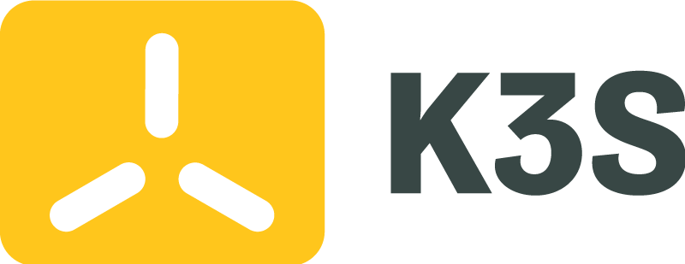







Products and Projects
RANCHER
Flagship product – Rancher Multi-cluster Manager is world’s most popular Kubernetes Management platform
A CNCF-certified Kubernetes distribution that built to the security requirements of the DoD/IC
A CNCF-certified, Lightweight Kubernetes distribution. Easy to install, half the memory, all in a binary less than 100MB
COMMERCIALLY SUPPORTED PRODUCTS
HARVESTER
Highly availablepersistent block storage for microservices-based, stateful applications
Kubevirt-powered Hyperconverged Infrastructure (HCI) for deploying traditional VMs on Kubernetes Coming Soon
GitOps & Continuous Delivery at scale. Deploy & manage thousands to millions of clusters at the network edge
OPEN SOURCE PROJECTS
Built to connect overlay networks of different Kubernetes clusters
20
Notes:
20

Slide 21





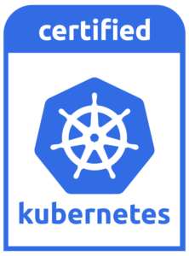
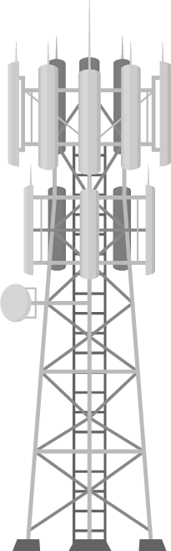
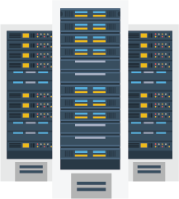

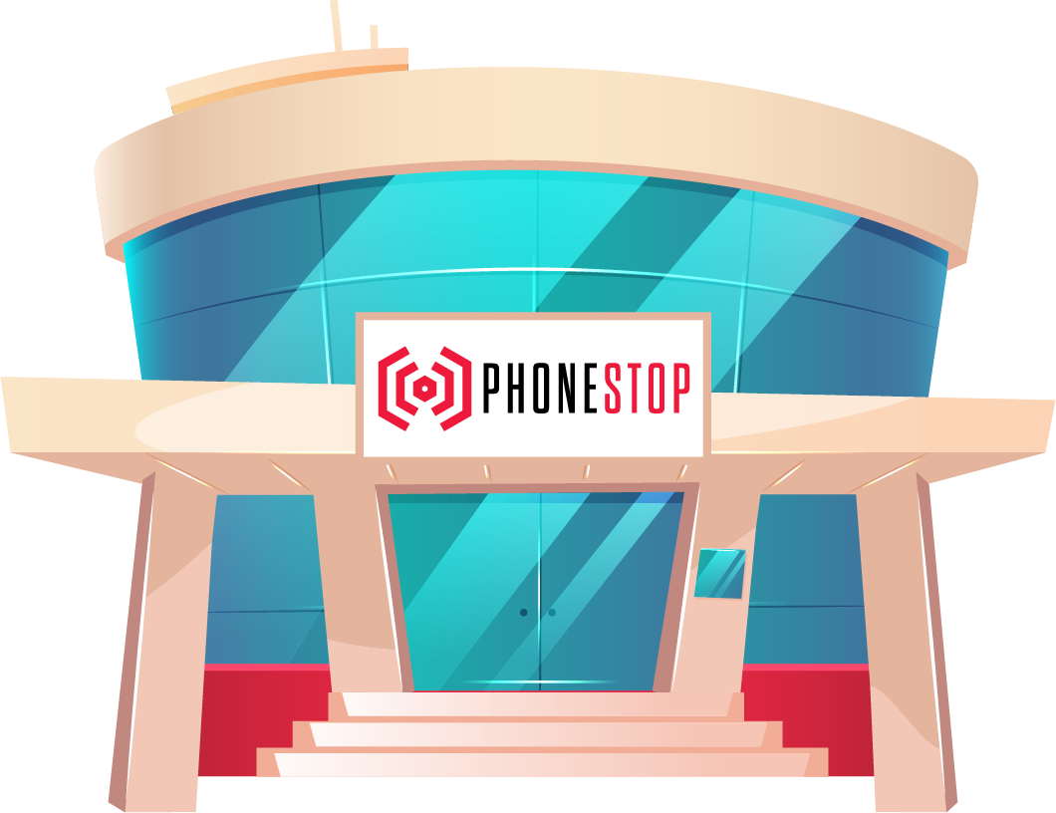

Rancher: Meeting You At Your Mission
Containerized App 1
Containerized App 2
Containerized App 3
Platform Services (Build and Run)
Rancher Catalog
Monitoring & Alerts
Dashboards & Observability
Service Mesh
Terraform Operator
Longhorn Storage
Security & Authentication
Policy Enforcement & Governance
Centralized Audit
Monitoring & Logging
CIS Benchmarking
RBAC, OPA, Pod & Network Policies
Simplified Cluster Operations & Infrastructure Management (Run and Manage)
Kubernetes Version Management
Dashboard, Monitoring and Diagnostics
Advanced Infrastructure Monitoring & Alerting
Cluster Templates & Config Enforcement
Node Pool Management
Cluster Provisioning & Lifecycle Management
Amazon
EKS
Azure
AKS
Google
GKE
Datacenter
Cloud
Dev
Branch
Edge
Notes:
21

